Slide 1

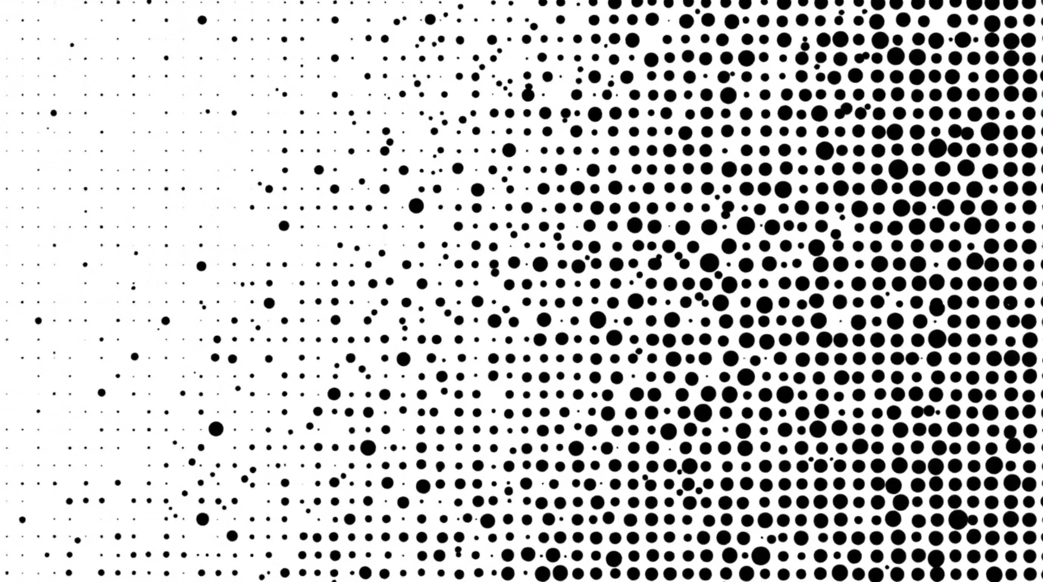
Computer Graphics
Halftone Patterns & Dithering Techniques
Lecture-16
Md. Mahabul Alom Santo Lecturer Department of Computer Science and Engineering Daffodil International University, DIU

Slide 2
What is a Halftone Pattern?
Definition
Halftone patterns simulate continuous tones using black dots of varying sizes on white paper. This technique is essential when working with devices that can only produce binary outputs (on/off, black/white).
How It Works
From a distance, your eye blends the dots into smooth shades of gray. Larger dots = darker areas. Smaller dots = lighter areas.

Slide 3




Halftone Applications
Newspaper Printing
Magazines & Comics
Black ink creates grayscale images through dot patterns
Colour separation using cyan, magenta, yellow, and black dots
Laser Printers
Screen Printing
Desktop printing technology for documents and photos
Transferring images to fabric, posters, and merchandise

Slide 4







Halftone Pattern Classification
Amplitude Modulation
Frequency Modulation
Dot size varies, spacing stays fixed
Dot spacing varies, size stays fixed
Hybrid Methods
Combines both amplitude and frequency modulation

Slide 5

What is Dithering?
Definition
Dithering is a technique that creates the illusion of more
colours by strategically placing pixels of available colours
next to each other. Unlike halftone patterns that use varying
dot sizes, dithering uses a fixed grid of pixels, mixing
available colours to simulate unavailable ones through
visual blending.
Why Use Dithering?
Smooth gradients with fewer colours
Reduce visible colour steps
Create realistic textures
Improve image quality

Slide 6



Halftone vs Dithering
Halftone Patterns
Key Difference
Dithering Techniques
Physical printing process
Large dot patterns
Amplitude modulation
Printer-focused
Halftone uses physical dot placement for printing; dithering uses pixel-level noise for digital displays.
Screen-based rendering
Pixel-level manipulation
Error diffusion
Display-focused

Slide 7
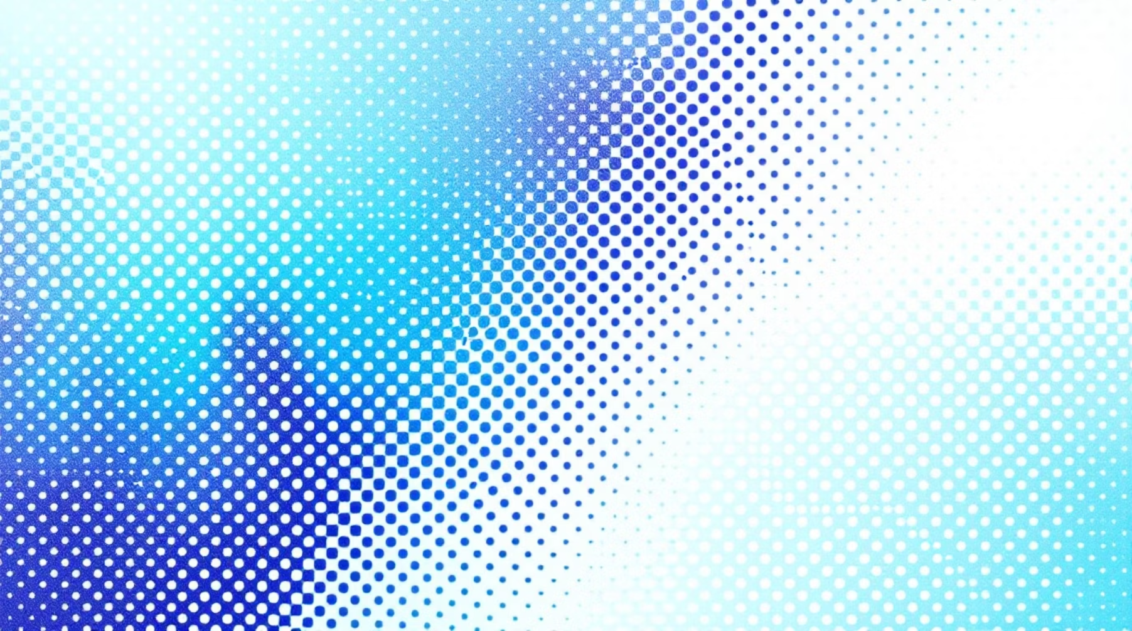

Visual Comparison: Halftoning vs Dithering
Halftoning
Dithering
Regular, geometric dot patterns
Predictable spacing and arrangement
Excellent for printing applications
Classic newspaper appearance
More randomised, noise-like patterns
Irregular dot distribution
Better for digital displays
Reduced visible patterning

